Slide 1
Data Science with Python
muksurat choudhury

Slide 2
Unsupervised Machine Learning
Select a dataset of your choice and create an unsupervised machine learning algorithm to provide further insight into the data.
Start with some exploration of the data – what are the fields, how are they distributed, will they require any transformations?
Prepare the dataset for machine learning
Create an unsupervised machine learning model
Measure the accuracy of your model
Try using two different unsupervised learning algorithms and use methods to measure their accuracy. Which model would you choose? Why?
Dataset 1 – Customer Data
Dataset 2 – Wine Quality
Dataset 3 – Country Data

Slide 3
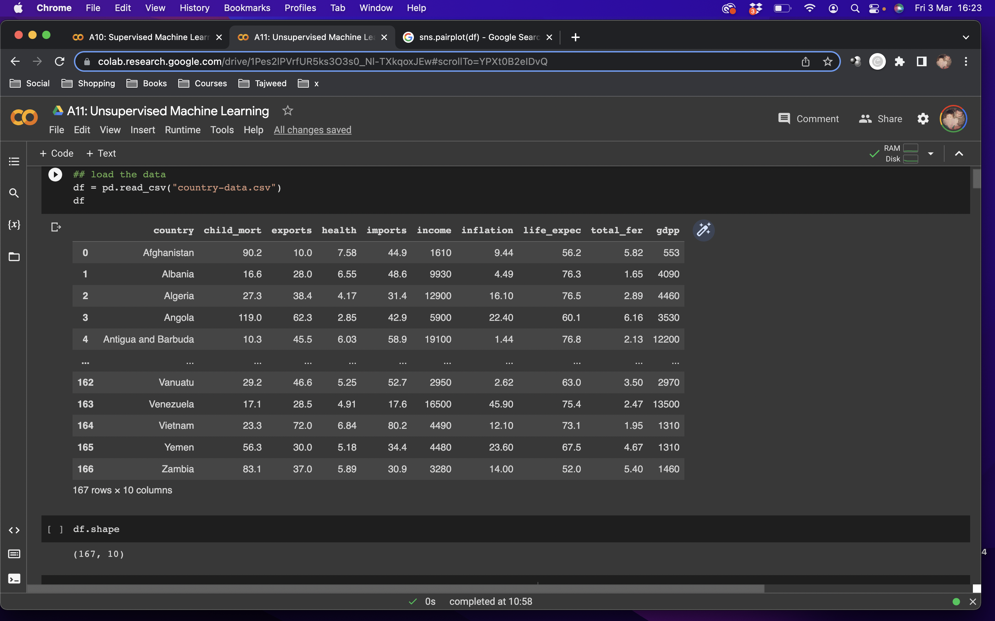
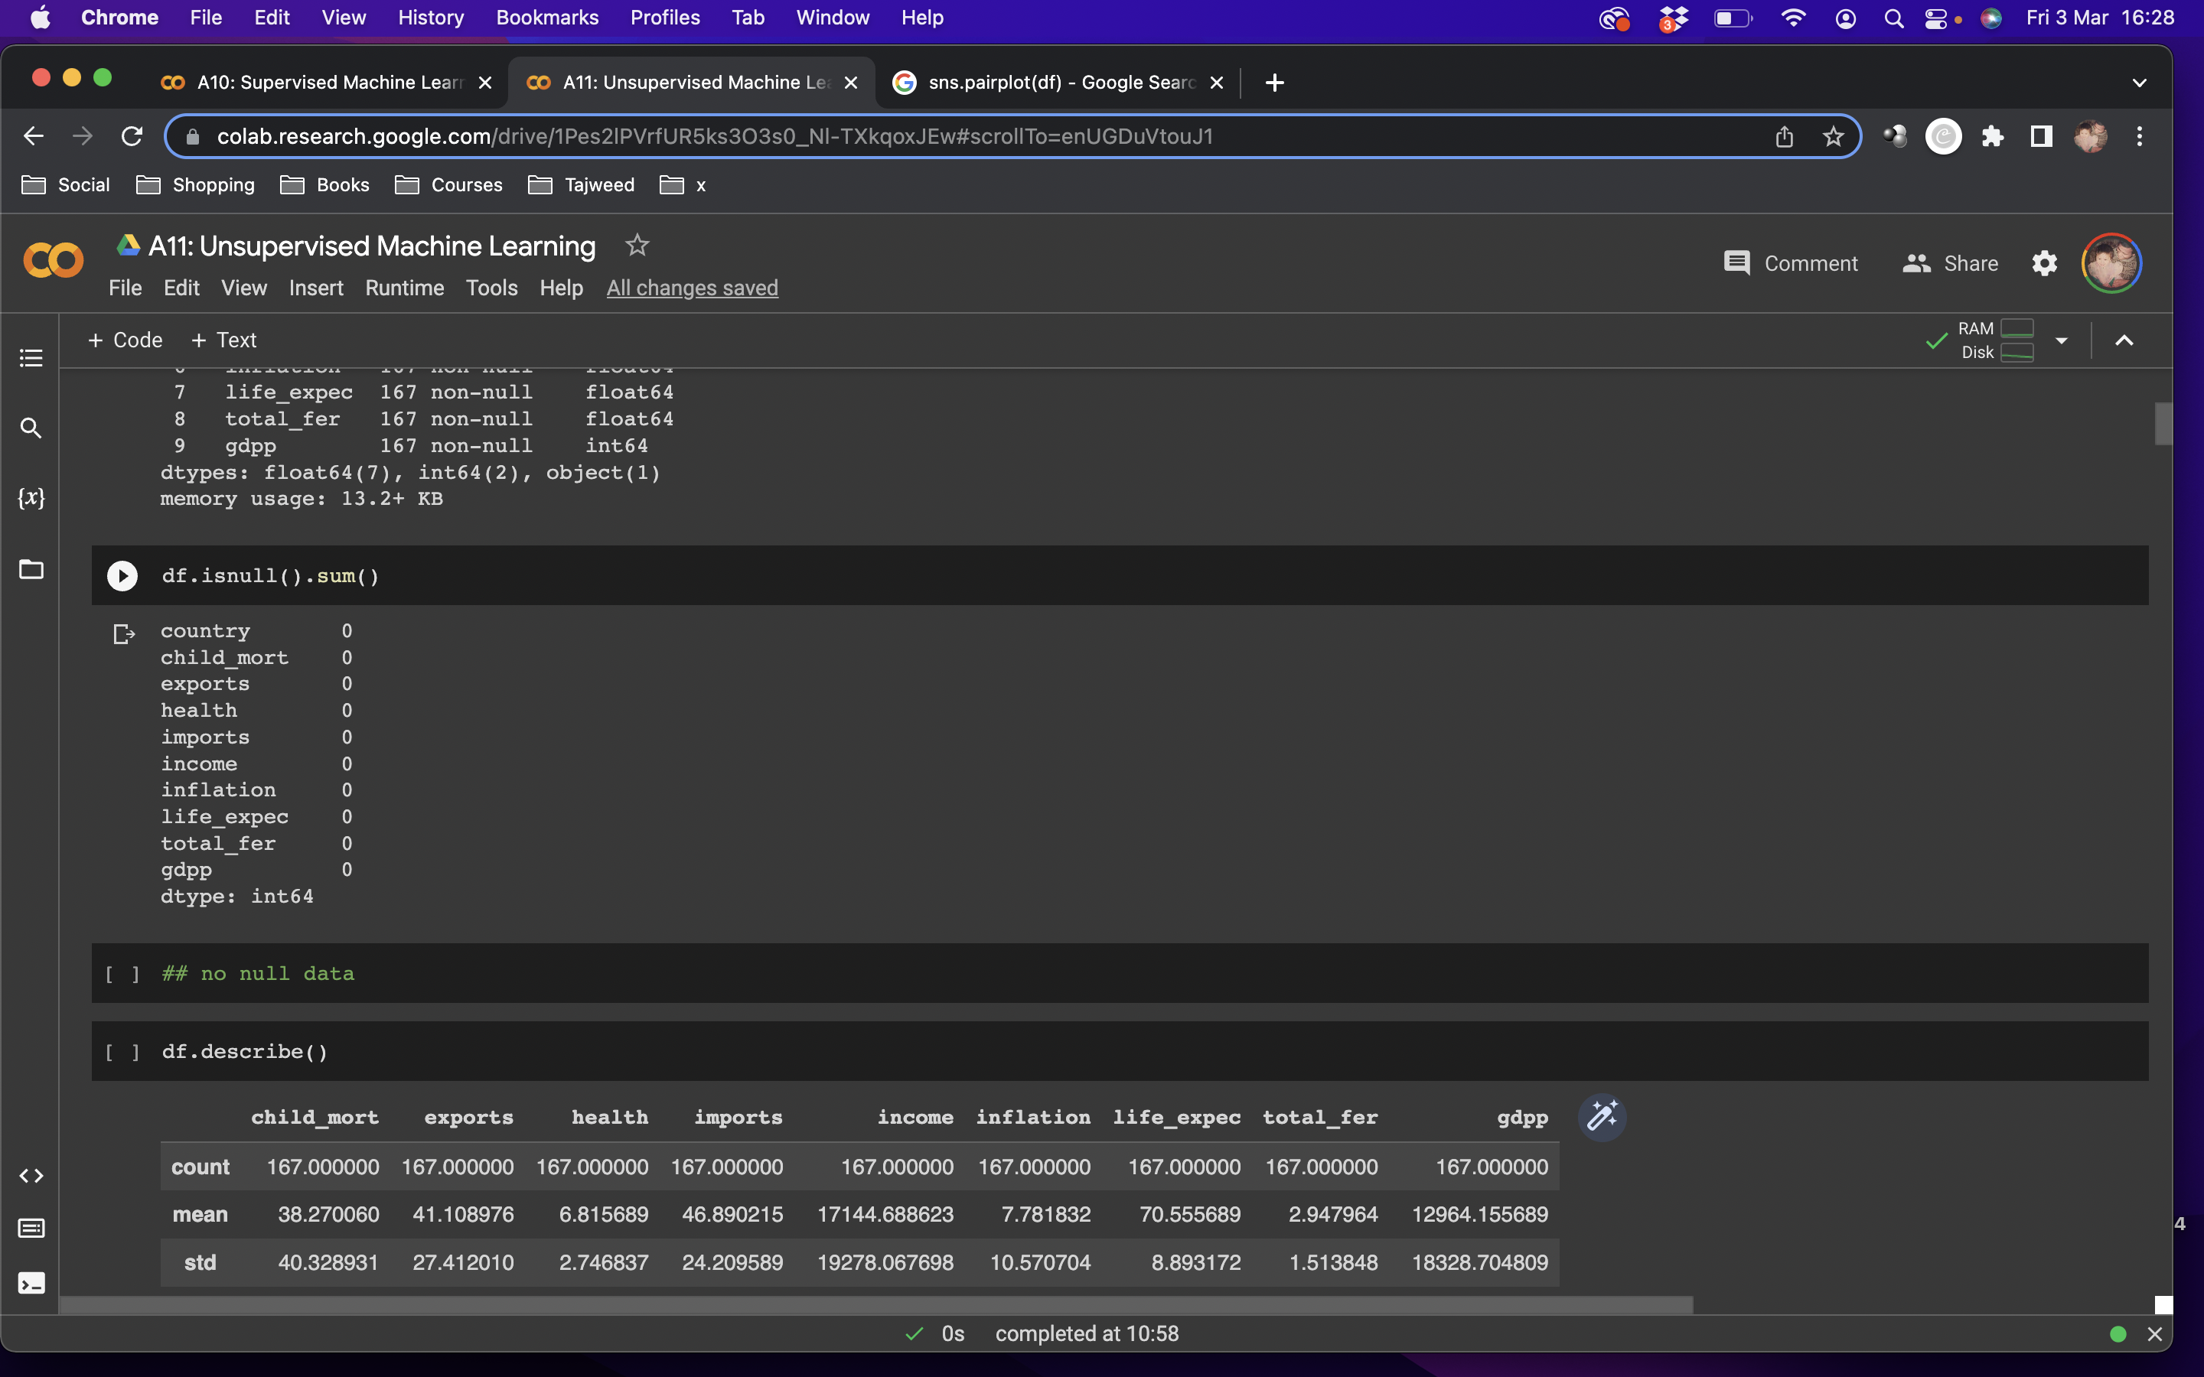
The Data: Country
Notes:
no null data

Slide 4
country: Name of the country child_mort: Death of children under 5 years of age per 1000 live births exports: Exports of goods and services per capita. Given as %age of the GDP per capita health: Total health spending per capita. Given as %age of GDP per capita imports: Imports of goods and services per capita. Given as %age of the GDP per capita income: Net income per person inflation: The measurement of the annual growth rate of the Total GDP life_expec: The average number of years a new born child would live if the current mortality patterns are to remain the same total_fer: The number of children that would be born to each woman if the current age-fertility rates remain the same gdpp: The GDP per capita. Calculated as the Total GDP divided by the total population
Dictionary

Slide 5

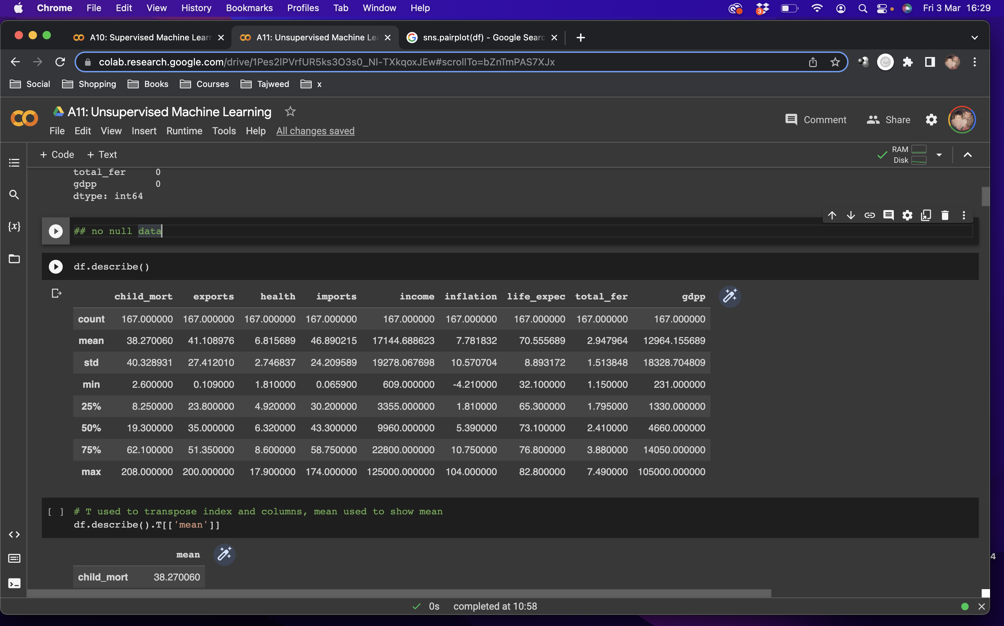
The Data: Country
Notes:
T used to transpose index and columns, mean used to show mean

Slide 6
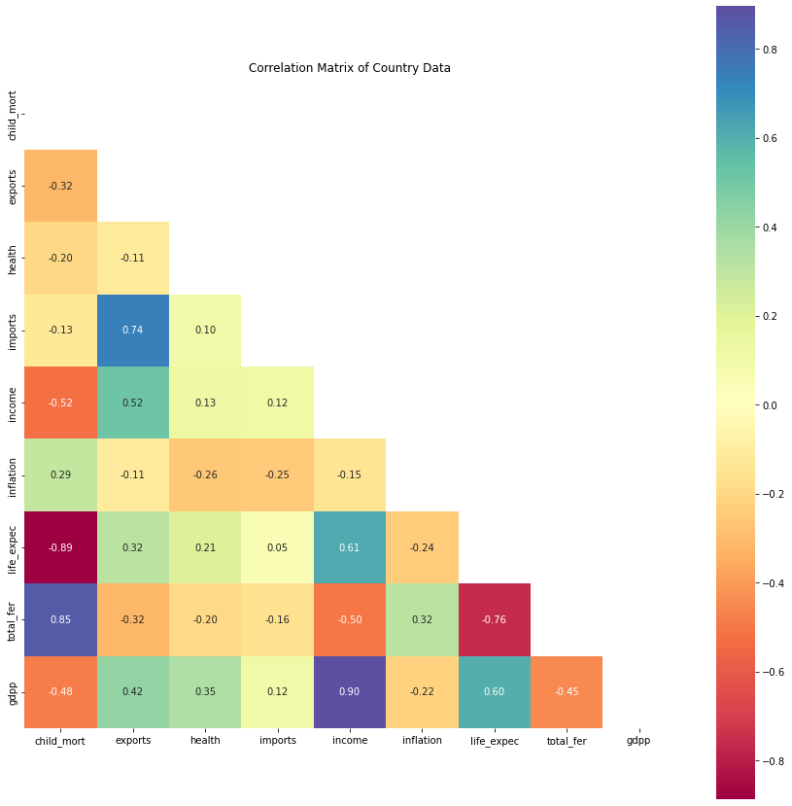
Data Analysis
Notes:
## income is highly correlated with gdpp at 90%
## child mortality is highly correlated with total fertility rate at 85%
## exports and imports are correlated at 74%
## child mortality and life expectancy are very negagively correlated at -89% meaning child mortality is high when life expectancy goes down
## child mortality is low when income and gdpp is high
## when income is high, life expectancy is also high
## when income is low, total fetility is low
## when life expentancy is high, total fertility is low at -76%
## when life expentancy is high, gdpp is also high

Slide 7
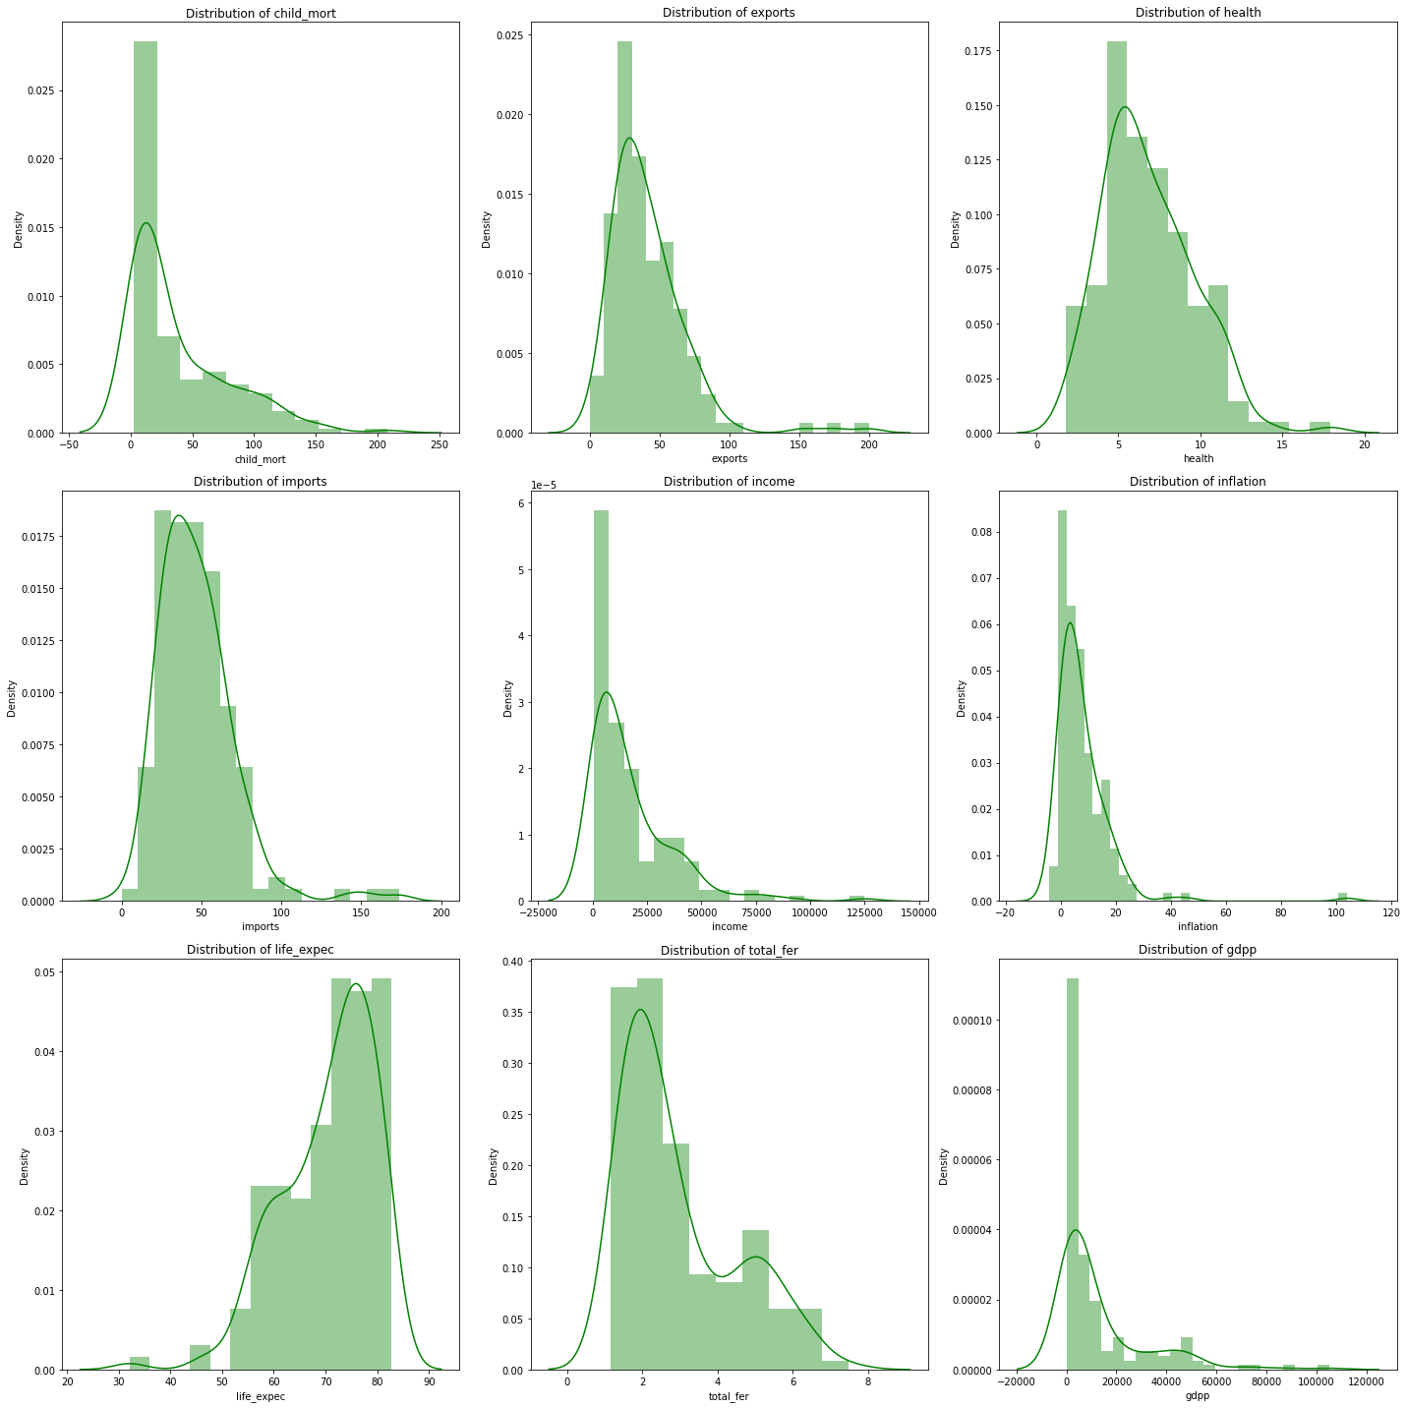
Notes:
## postively skewed: child mortality, exports, imports, income, inflation, total fetility, dgpp
## negatively skewed: life expectancy
## fairly normal distribution: health

Slide 8
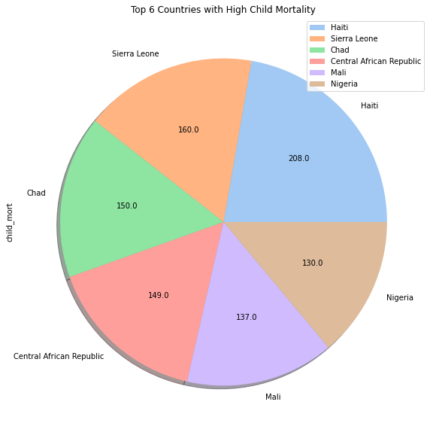
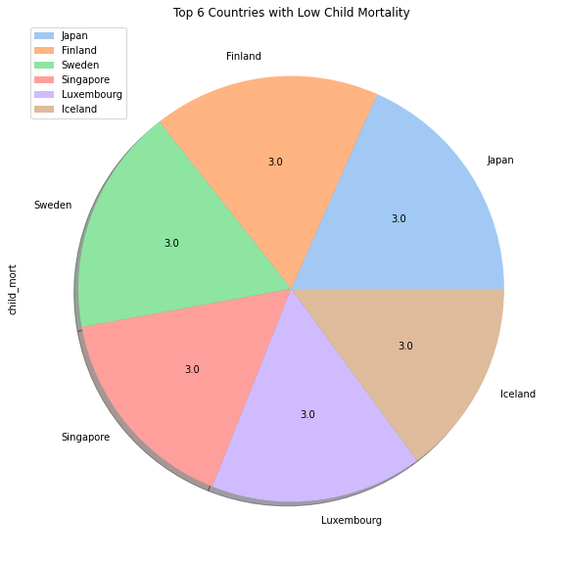
Notes:
## Haiti (Central America) has the highest number of child mortality
## other countries located in Africa are also seen in the top 6 of highest child mortality
## European countries and few Asian countries have the lowest child mortality rates

Slide 9
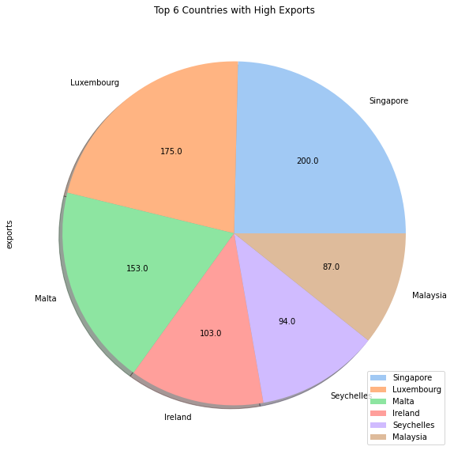
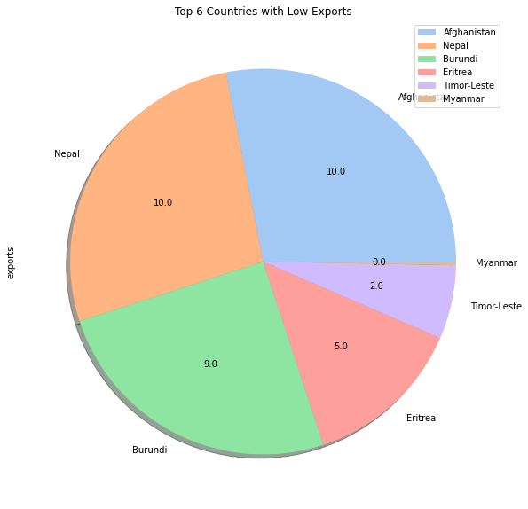
Notes:
## Singapore has the largest number of exports
## some European countries are also in the top 6 for highest exports
## Some of the countries with low exports are in Africa and Asia

Slide 10
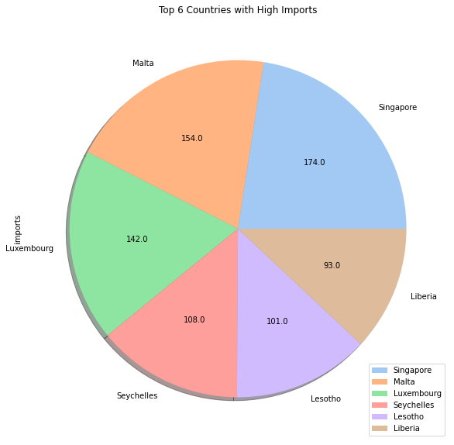
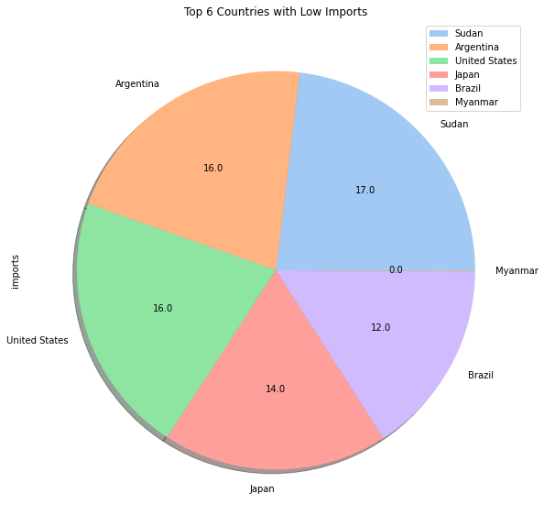
Notes:
## Singapore, Malta, Luxembourg and Seychelles are in the top 6 for importing the most as well as exporting the most
## Myanmar and Brazil are among the countries with the least imports, Myanmar being at 0 for both imports and exports
## Sudan, Argentina, US and Japan are other countries that have low imports

Slide 11
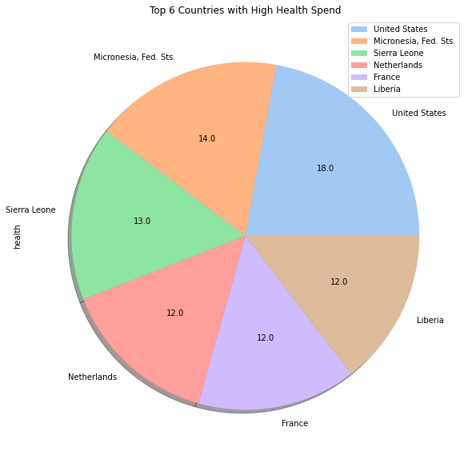
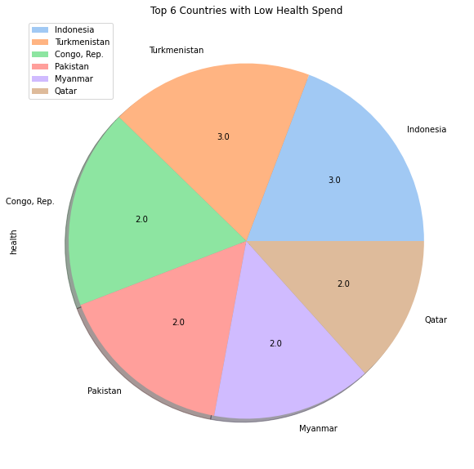
Notes:
## US spends the most on health, followed by some European countries
## Asian countries spend less on health

Slide 12
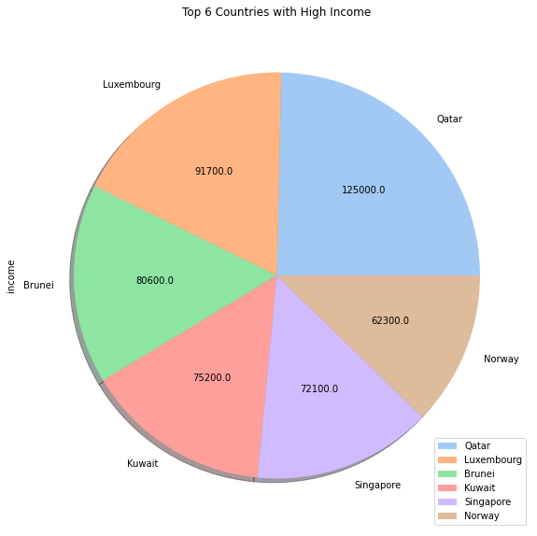
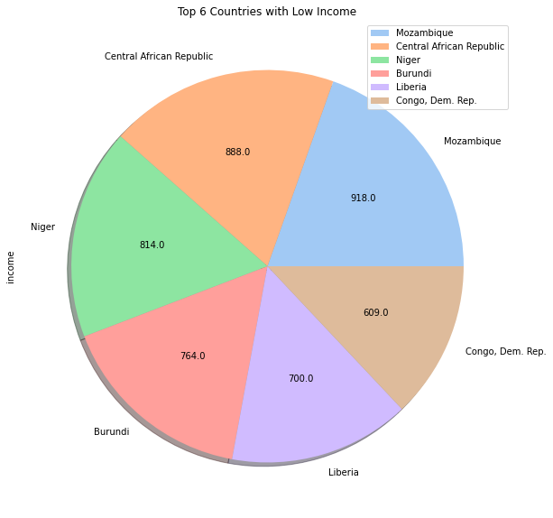
Notes:
## Qatar has the highest income
## some South Asian countries are in the top 6 for income
## some African countries are seen in the top 6 for least income

Slide 13
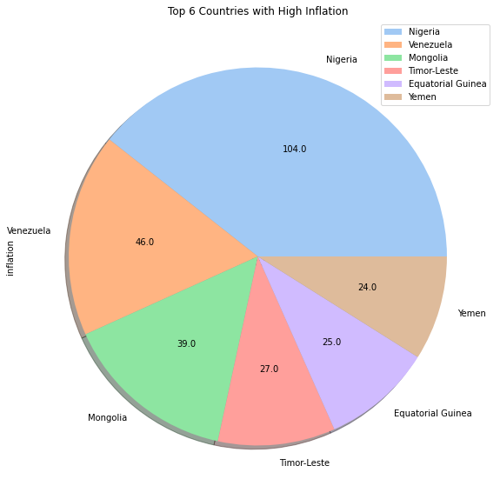
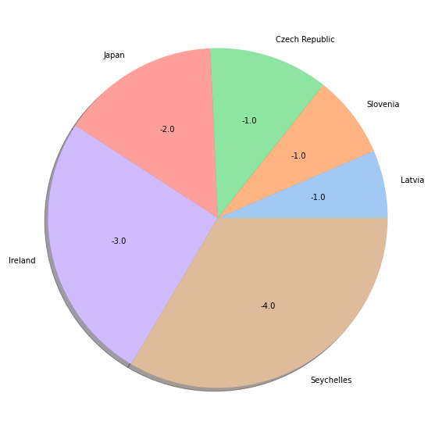
Top 6 Countries with Low Inflation
Notes:
## Nigeria has the most inflation by far
## Some countries have negative inflation, meaning deflation

Slide 14
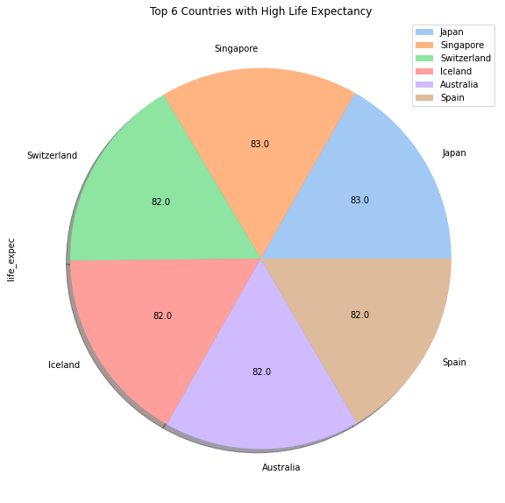
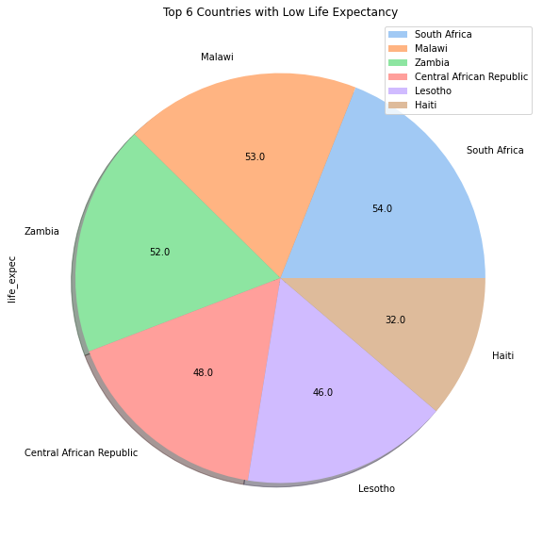
Notes:
## The top countries with highest life expectancy are very similar from 82-83
## African countries have the lowest life expectancy and are featured in the last 6 again

Slide 15
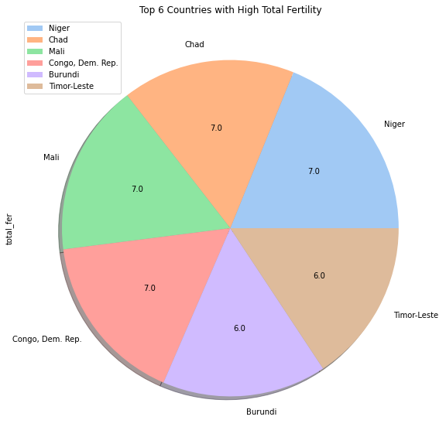
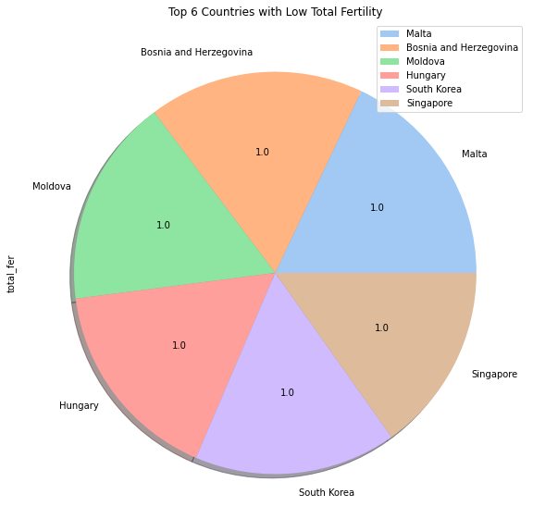
Notes:
## African countries have the highest fertility rates
## there is a mix of Asian and European countries with the lowest total fertility
## the lowest fertility is 1

Slide 16
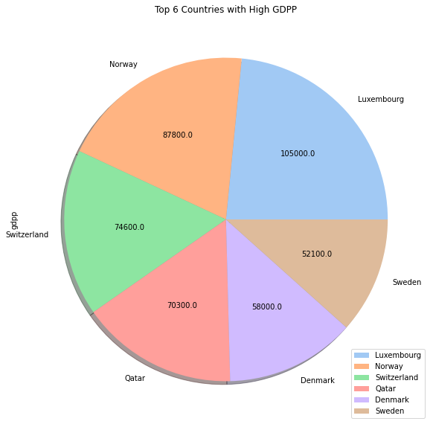
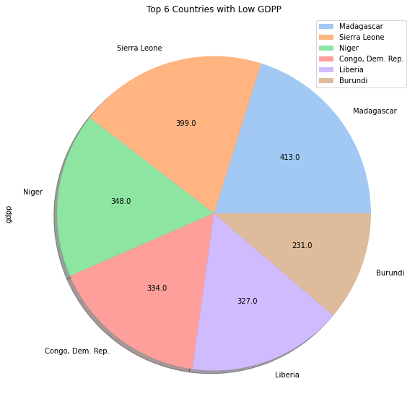
Notes:
## some of the countries with the highest GDPP are European countries
## Luxembourg features among the top six countries again and has the highest GDPP
## African countries feature in the bottom 6 again
## conclusion:
# most African countries feature in the bottom 6 where they have lower income and GDPP, but import more
# this shows African countries are more dependent on other countries
# inflation, fertility rate and child mortality are high causing a low life expectancy in these countries

Slide 17
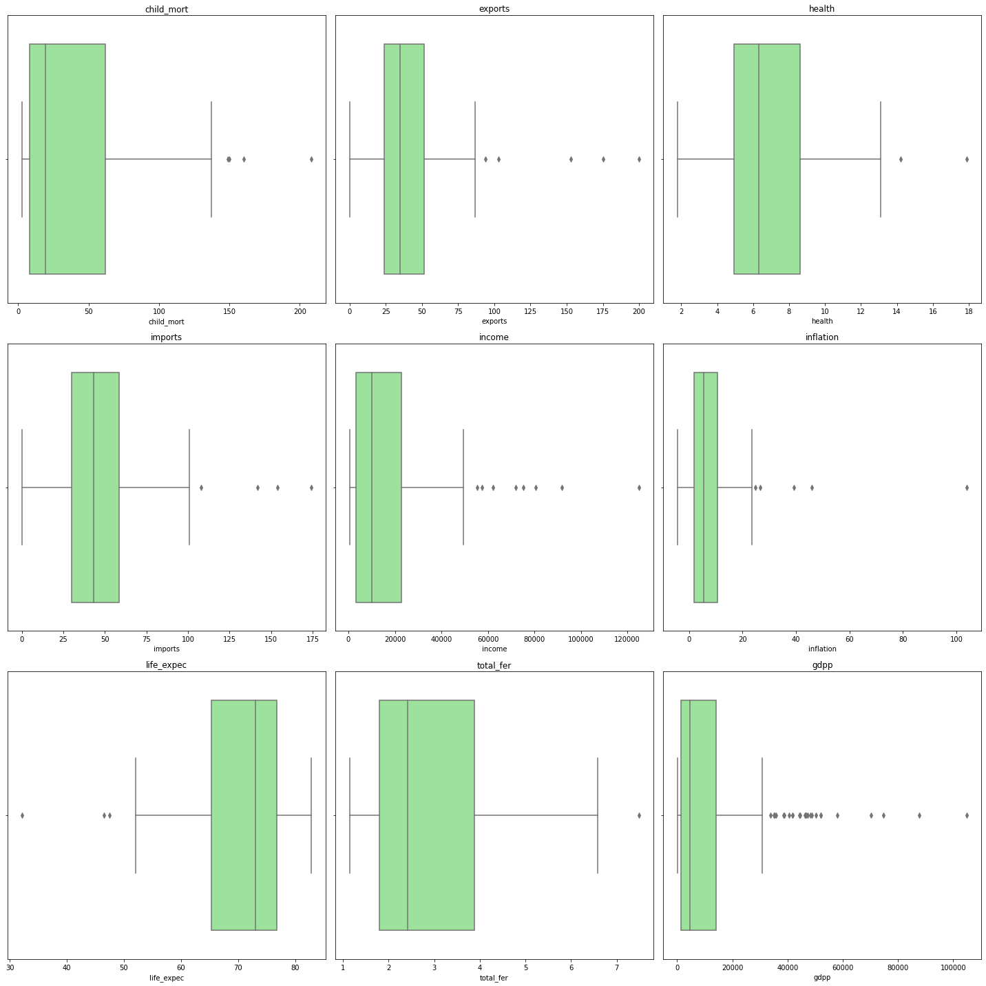
Notes:
## OUTLIERS

Slide 18
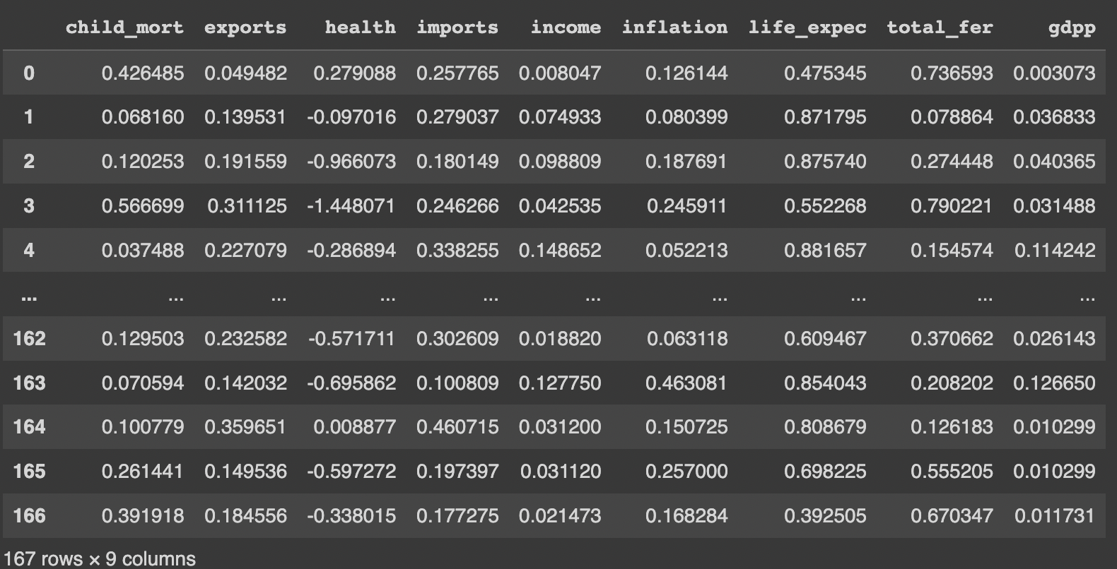
Data Pre-processing
Notes:
# standardise/normalise data
# standardise 'health' column due to normal distribution
## normalise all other columns

Slide 19
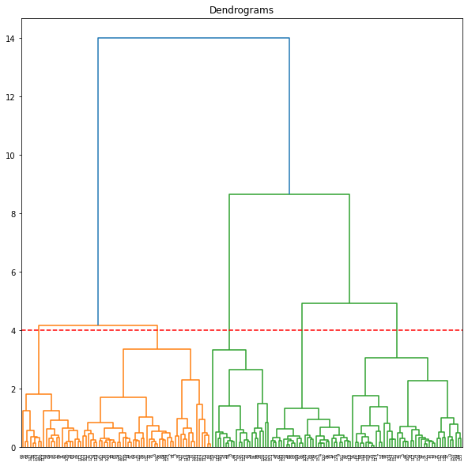
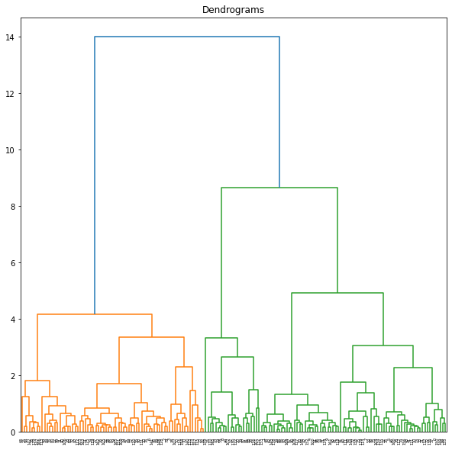
Notes:
## if we break the clusters from 4, we will have many clusters

Slide 20
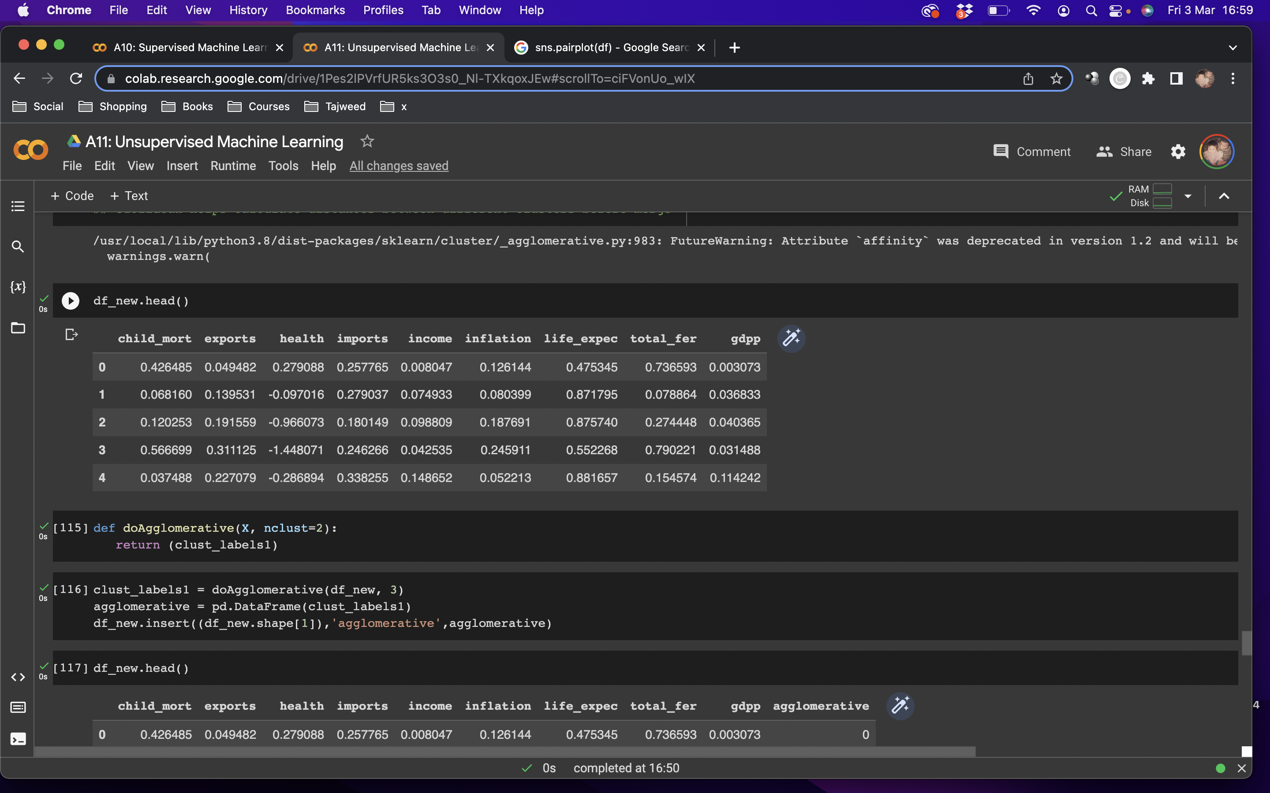
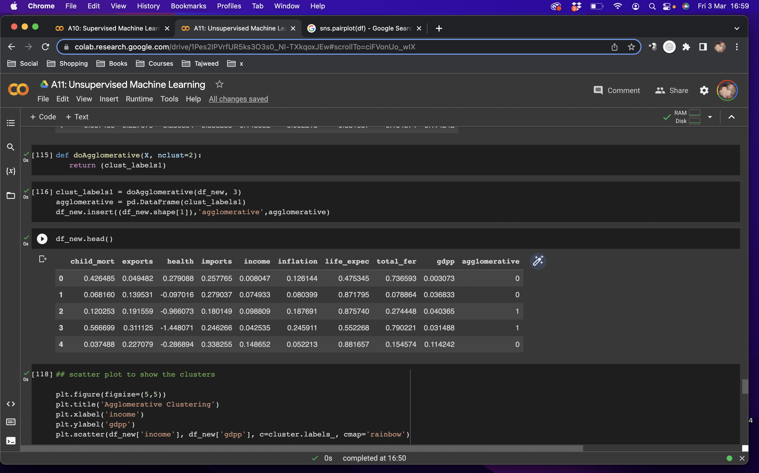
Notes:
## assign entries to cluster 0 or 1 in agglomerative column

Slide 21
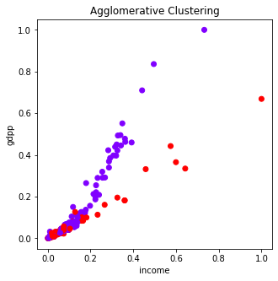
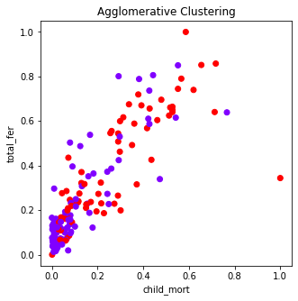
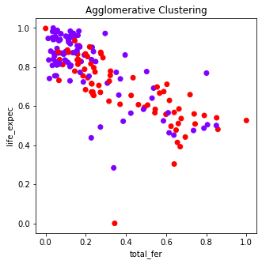
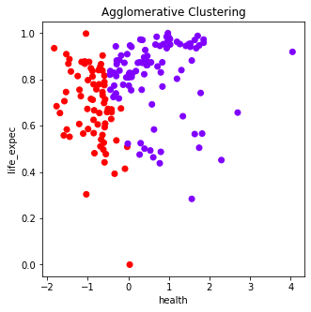
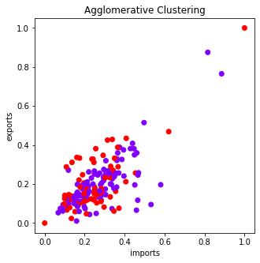
Notes:
## scatter plot to show the clusters

Slide 22
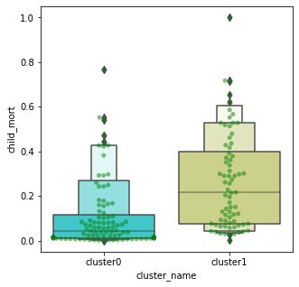
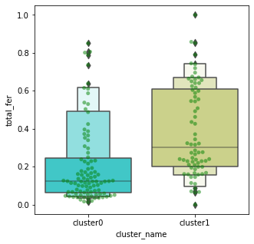
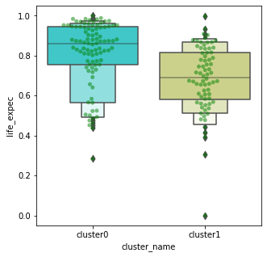
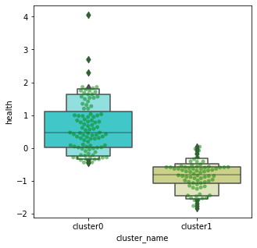
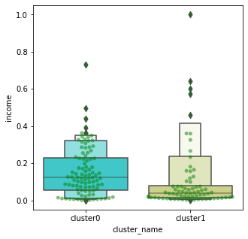
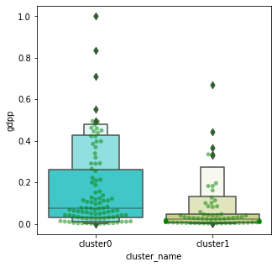
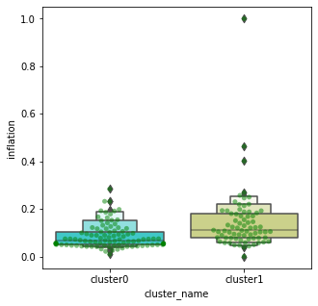
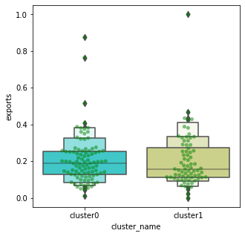
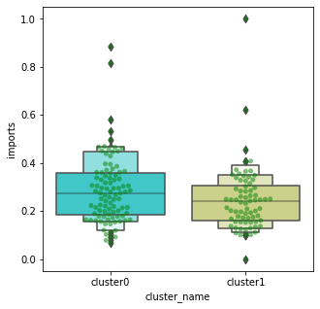
Notes:
## comparer clusters 0 and 1
## child mortality is lower in cluster0 than cluster1
## total fertility rate is also lower in cluster0 than cluster1
## life expectancy is higher in cluster0 than cluster1
## health spend is also higher in cluster0 than cluster1
## average income is greater in cluster0 than cluster1
## gdpp is also greater in cluster0 than cluster1
## inflation is lower in cluster0 than cluster1
## cluster1 have greater exports than cluster0
## cluster0 have greater imports than cluster1

Slide 23
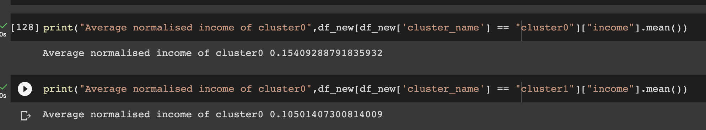
Notes:
## comparer mean of clusters 0 and 1
## can repeat cluster process without standardising/normalising dataset to get actual values of average life expectancy and average income

Slide 24
Conclusion
Notes:
## conclusion:
# cluster0 are mostly developed countries with low fertility rates and low child mortality with high spending on health, therefore higher life expectancy
# where income and gdpp are high and inflation is low
# cluster1 are mostly undeveloped countries with higher fertility rates and higher child mortality with low spending on health, therefore lower life expectancy
# where income and gdpp are low and inflation is high
## countries that might need help from charity are the undeveloped countries mostly located in Africa and some parts of Asia
## can repeat cluster process without standardising/normalising dataset to get actual values of average life expectancy and average income

Slide 25
Thank you!

